Slide 1
Economics 144 Economic Forecasting
Lecture 6
White Noise
Dr. Randall R. Rojas

Slide 2
Today’s Class
White Noise
White Noise Example
R Demo

Slide 3



White Noise 1 of 3
Time Series Process: Let y denote the observed series of interest.
White Noise: Time series process with zero mean, constant variance, and no serial correlation.
Where ε_{t} (“shock”) is uncorrelated over time.
Therefore, y_{t} and ε_{t} are serially uncorrelated.
and

Slide 4

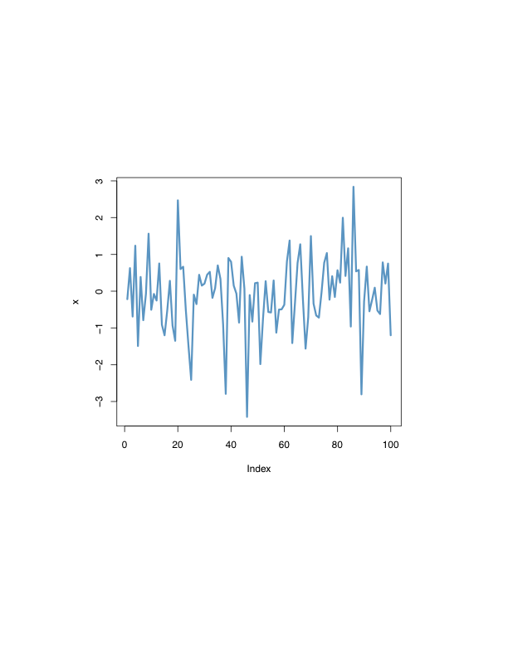
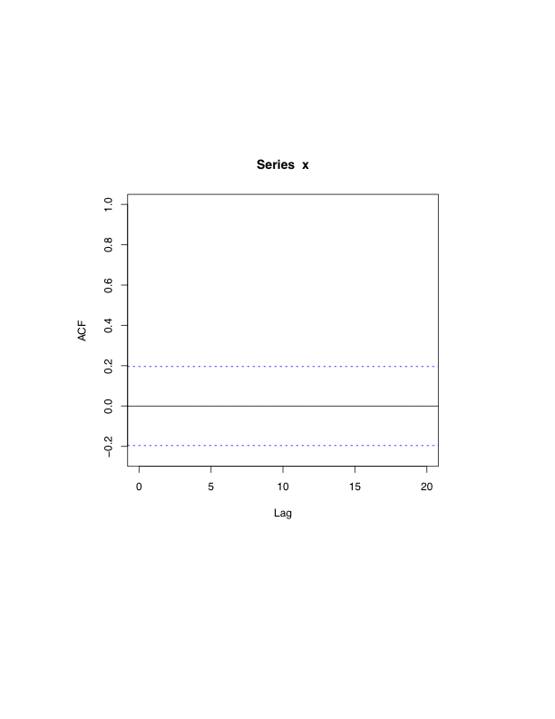
White Noise 2 of 3
Gaussian White Noise: If y is serially uncorrelated and normally distributed, and thus, serially independent .
Process
ACF
Time
Displacement

Slide 5
White Noise 3 of 3
Given: →E(y_{t}) = 0 and var(y_{t}) = σ²
However, recall that σ² = γ(0)→
σ², k =0
0, k ≥ 1
1, k =0
0, k ≥ 1
γ(k) =
and
ρ(k) =
Autocovariance Function
Autocorrelation Function
1, k =0
0, k ≥ 1
Note 1: Please solve problems 3
and 4 from Chapter 7^{b}.
Note 2: Please review conditional
means and conditional variances
(see e.g., page 122^{b}).
p(k) =
Partial Autocovariance Function

Slide 6
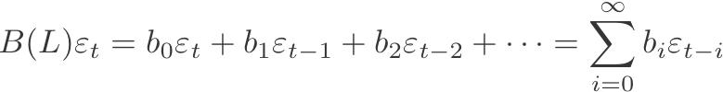
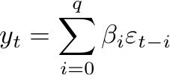
The Lag Operator (Review)
Recall: Distributed lag of current and past shocks:
Example: Use a white-noise process to construct a more complex time series:
,

Slide 7
White Noise Example (Moving Average)
Example: Suppose you win $1 if a fair coin shows heads and loose $1 if it shows tails.
Denote the outcome on toss t by ε_{t} (i.e., for toss t, ε_{t} is either +$1 or -$1).
If you want to keep track of your ‘hot streaks’, you can e.g., calculate your average winnings on the last four tosses. For each coin toss t, your average payoff on the last four tosses is:

Slide 8
White Noise Example (Moving Average)
Case 1: We can set e.g., β_{i} = ¼ for i≤3.
Case 2: We can set e.g., β₀ = β₁ = 1, and all other β_{i} =0.
For this case, although the {ε_{t}} sequence is a white-noise process, the constructed {x_{t}} sequence will not be a white-noise process is two or more of the β_{i} differ from 0.
E[x_{t}] = E[ε_{t} + 0.5ε_{t-1}] = 0 and
var[x_{t}] = var[ε_{t} + 0.5ε_{t-1}] = 1.25σ²
cov(x_{t}, x_{t-1}) = 0.5σ² ≠ 0
White-noise conditions
are satisfied.
→{x_{t}} is not a white noise process!
Note: Case 2 is known as an ‘MA(1)’ Process

Slide 9



Estimation and Inference 2 of 3
Q: How can we assess whether a series is reasonably approximated as white noise?
A: If the series is white noise, then for large samples:
The sample autocorrelations are unbiased
estimators of the true autocorrelations.
Square both sides

Slide 10
For Next Class
Readings about today’s class:
Chapter 7^{b}
Review Exercises / Problems:
Chapter 7^{b}: 3, 4, 5, 8, 10, 11
Readings for next class:
Chapter 6ª

